Slide 1
HIT140 Group Assignment 2 Group 68
Adrian Voljak, Md Shibbir Talukder Turag, Manoj Thapa, Sasmit Tmalsina.

Slide 2

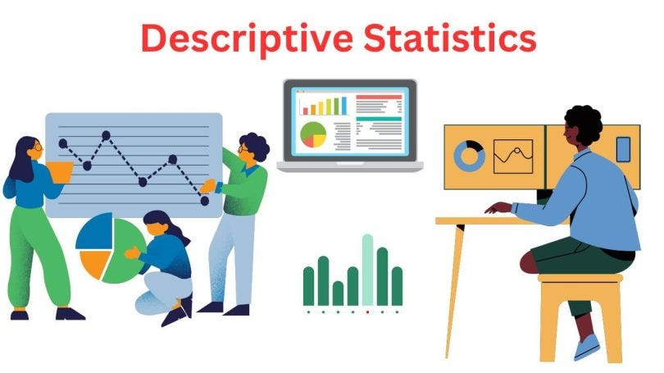
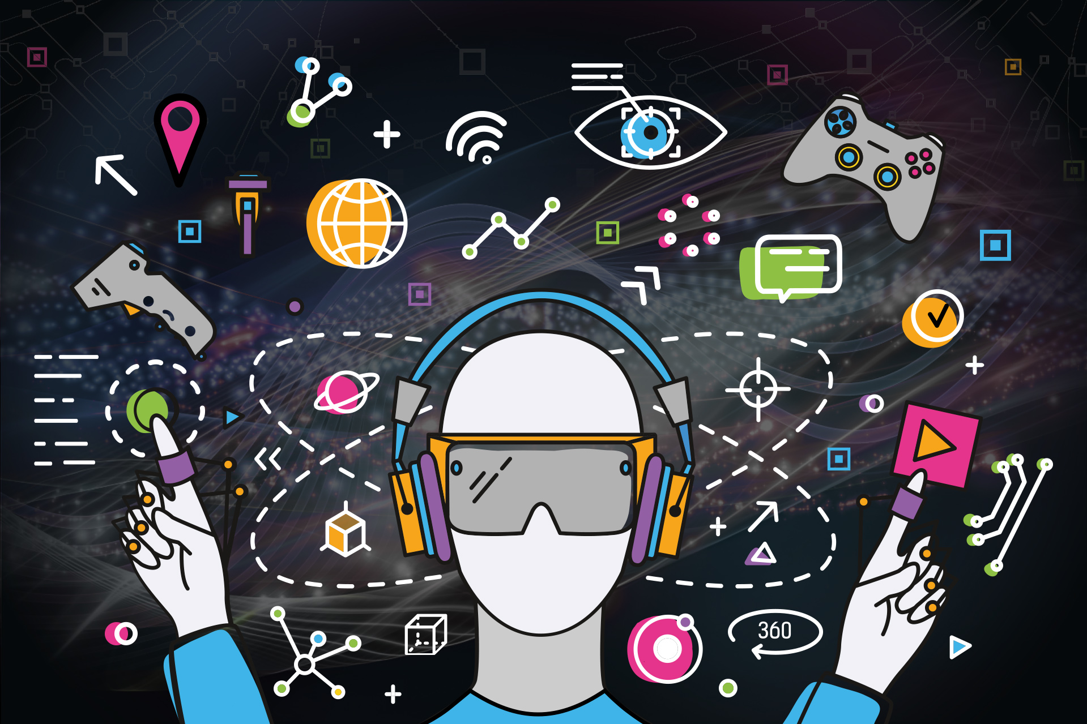
Descriptive Statistic Investigation 1 – Presented by Turag

Slide 3
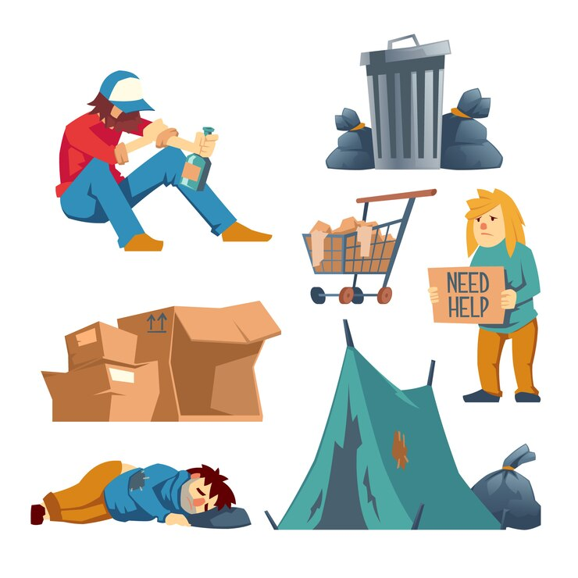
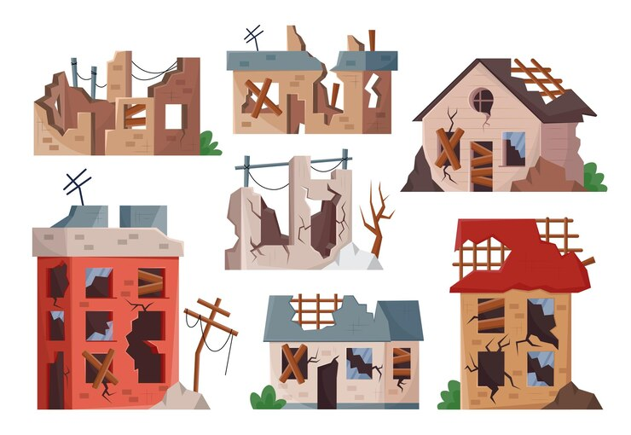
Deprivation Areas and its effects on Social Media Consumption

Slide 4
Deprivation Areas and its effects on Social Media Consumption
From dataset 1:
Created two separate lists and takes note of them via the ID column. The variables were called: 1) ids_deprived
2) ids_not_deprived
From dataset 2:
Put a specific focus on the weekday and weekend columns of video games and TV. These columns respectively were called:
1)G_we
2)G_wk
3)T_we
4) T_wk

Slide 5
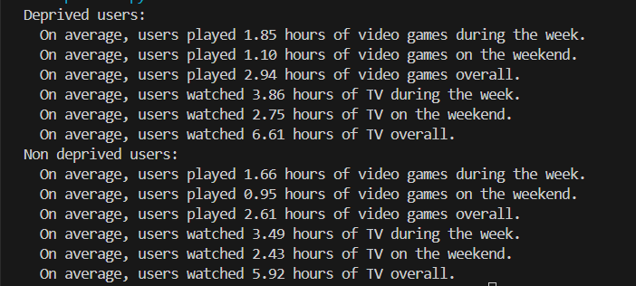
Overall Conclusion and Results of the Investigation

Slide 6
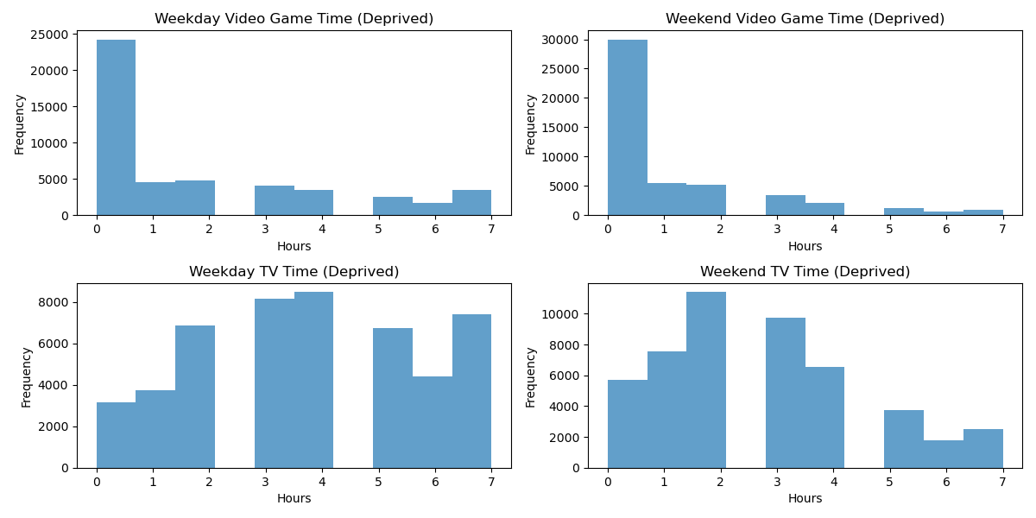
Histogram Displaying Data for Deprived Users

Slide 7
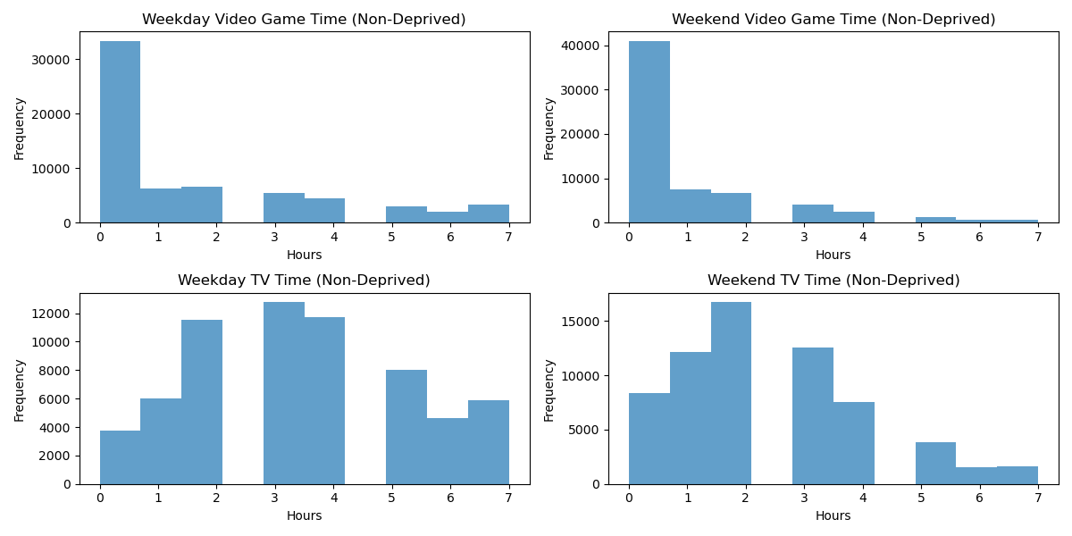
Histogram Displaying Data for Non-Deprived Users

Slide 8


Conclusion

Slide 9
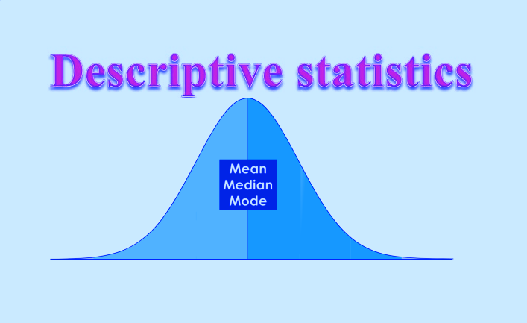
Descriptive Statistic Investigation 2 – Presented by Manoj

Slide 10
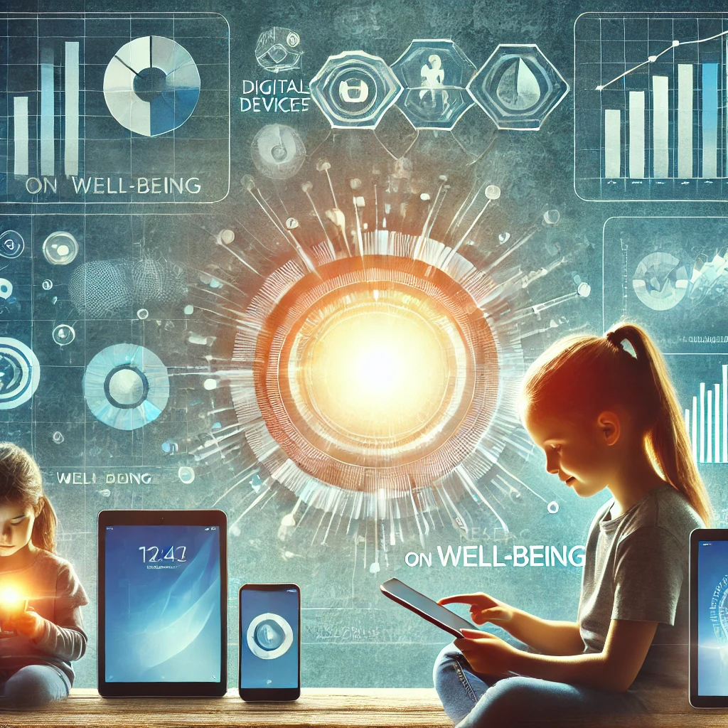
Analysing Outliers in Screen Time and The Psychological Impact
Introduction:
In this investigation, we explored how media consumption correlates with psychological and behavioural attributes using two datasets: screen time data (Dataset 2) and well-being scores (Dataset 3)
Objective:
To identify outliers in media consumption and determine their psychological/behavioural attributes, specifically focusing on respondents with negative feelings.

Slide 11
Data Overview
- Dataset 2: Contains screen time data across various electronic devices for approximately 113,000 respondents.
- Key variables track hours spent on electronic devices.
Dataset 3: Contains self-reported well-being indicators for 102,580 respondents.
Key variables track their score on a scale of 1-5, where 1 is the lowest, and 5 is the highest.

Slide 12
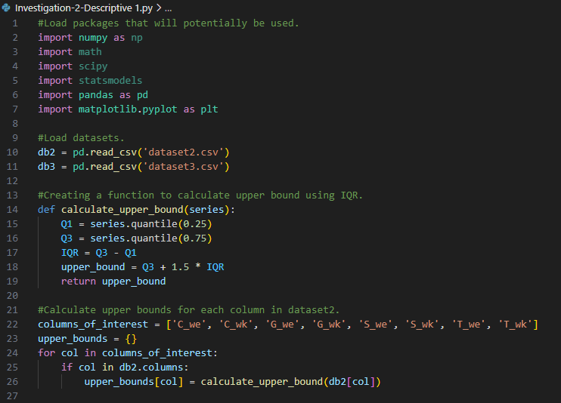
Methodology
Outlier Detection:
We calculated the IQR using python to detect outliers in media consumption from Dataset 2.
Outliers were identified and recoded based on the variables named “meeting_ids”.

Slide 13
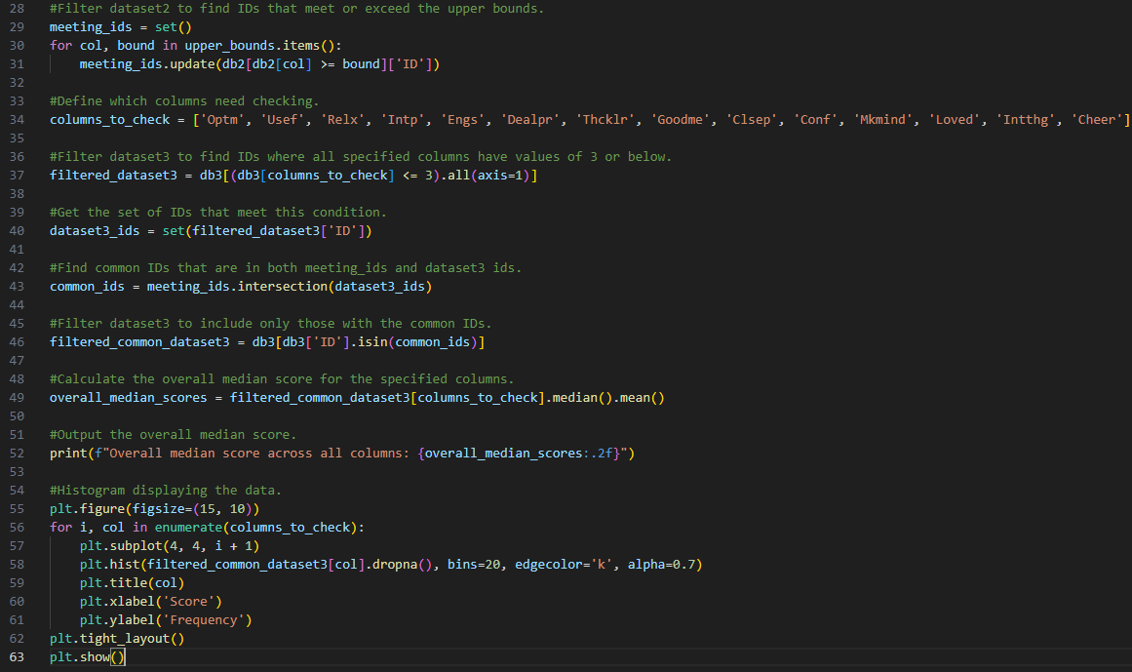
Methodology - Continued
Using the IDs of media consumption outliers, we filtered Dataset 3 to identify respondents who reported feeling negative scores.
Analysis: We analysed the frequency and median well-being scores of these outliers, focusing on how media consumption might impact psychological well-being.

Slide 14
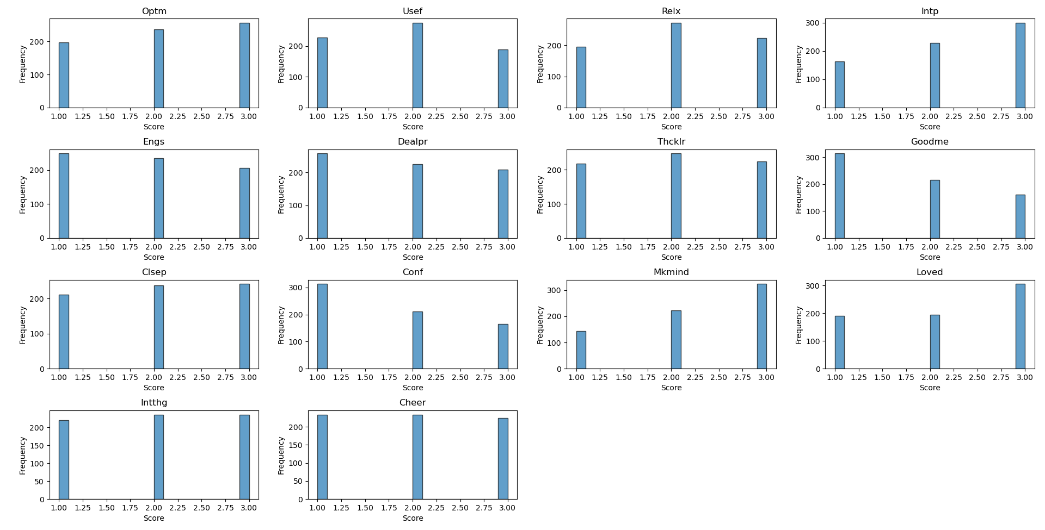
Data Visualisation

Slide 15
Findings and Conclusion
Findings:
The analysis suggested that extreme media consumption is associated with more negative feelings.
Respondents with high screen time often reported lower median well-being scores compared to those with average or lower media consumption.
Conclusion:
- The investigation offers valuable insights into the potential psychological impact of media consumption, suggesting a correlation between excessive screen time and diminished well-being.

Slide 16
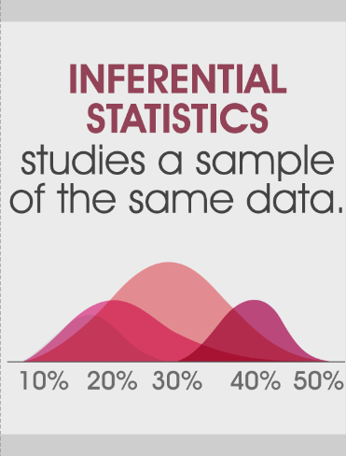
Inferential Statistics Investigation 1 – Presented by Sasmit
Focus on examining the relationship between the number of hours spent watching TV and the self-reported feeling of usefulness.
To find more information between this relationship we conducted a correlation test.

Slide 17
Introduction
- The investigation focuses on the relationship between TV watching hours and the self-reported feeling of usefulness.
- Two datasets are used: Dataset 2 (tracks overall screen time) and Dataset 3 (well-being scores) with a specific focus on the ‘Usef’ column.

Slide 18
Data Processing
- The investigation focuses on the relationship between TV watching hours and the self-reported feeling of usefulness.
- Two datasets are used: Dataset 2 (tracks overall screen time) and Dataset 3 (well-being scores) with a specific focus on the ‘Usef’ column.

Slide 19
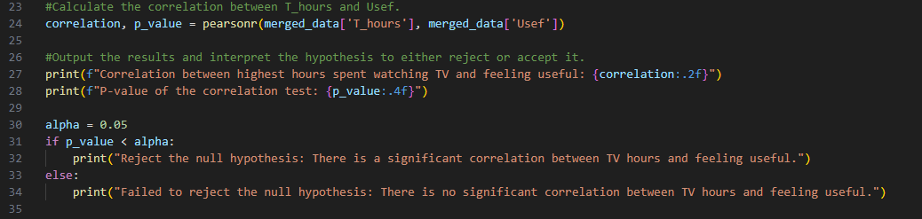
Correlation Analysis

Slide 20
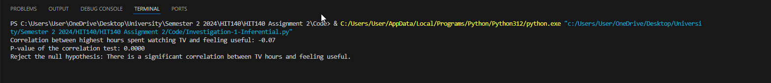
Conclusion
As seen with the screenshot of the outputted code below, the results show a significant correlation between TV watching hours and feeling of usefulness. Thus, the null hypothesis was rejected, indicating a meaningful relationship.

Slide 21
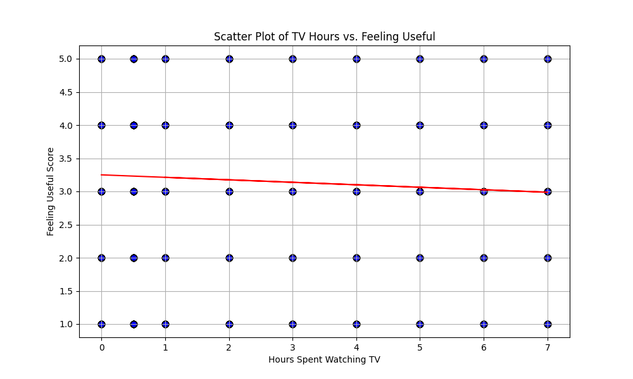
Visualisation of Data
Scatterplot was used to show the results seen in the slide before to help visualise the data.

Slide 22
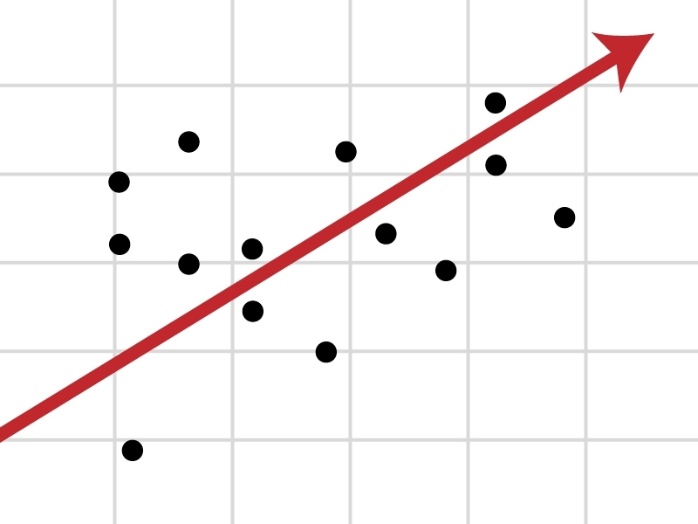
Inferential Statistics Investigation 2 – Presented by Adrian
Example of what a regression analysis looks like when graphed/visualised.

Slide 23
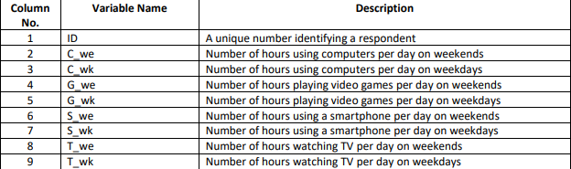
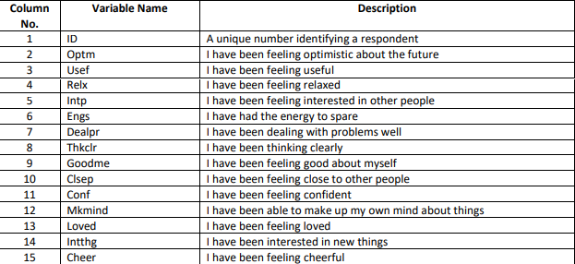
Setup for the Investigation
Dataset 2: Tracks overall screen time across various electronic devices.
Dataset 3: Includes a variety of responses to statements rated from a scale of 1 to 5.

Slide 24
Overview of Code Before Conducting the Regression Analysis
- Combined the weekday and weekend TV columns into one column named T_hours (similar to the previous investigation).
What was the Focus?
Focus on individuals who reported scores of three or lower out of the attributes: Usef (usefulness), Thcklr (thinking clearly), and Dealpr (dealing with problems).

Slide 25
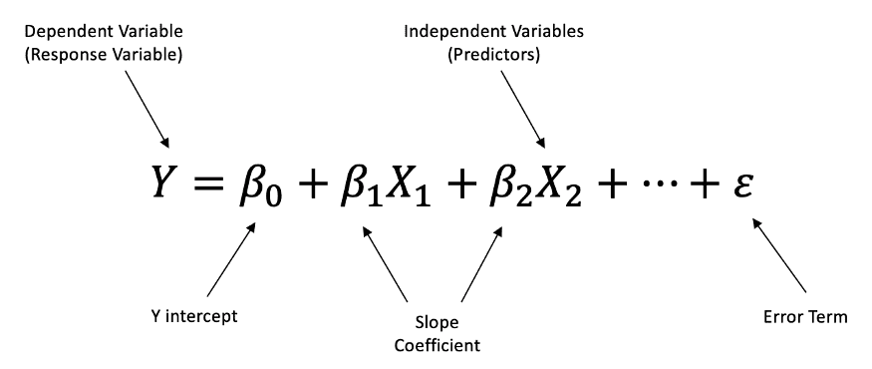
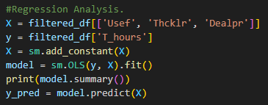
Formula for Conducting Regression Analysis

Slide 26
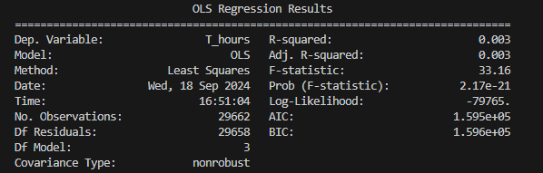
Overall Results
These results suggest that the psychological attributes have minimal explanatory power for the variation in TV viewing hours.

Slide 27
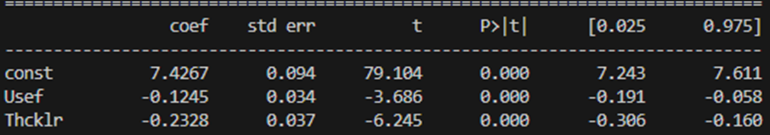
Extended Result Information on ‘Usef’ and ‘Thcklr’
These results suggest that as scores for feeling useful/thinking clearly decrease, TV viewing hours increase.

Slide 28
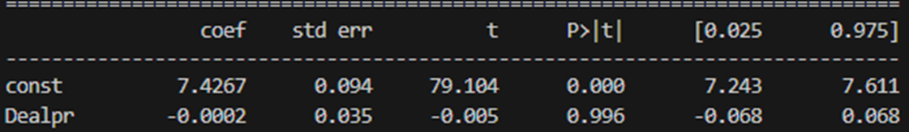
Extended Result Information on ‘Dealpr’
This result implies that the ability to deal with problems is not meaningfully related to the amount of overall time spent watching TV.

Slide 29
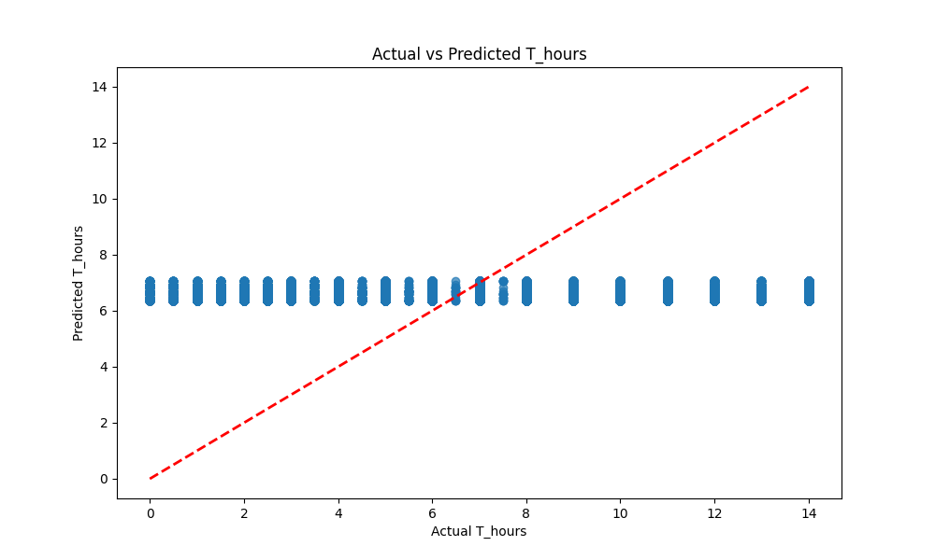
Visualisation of Data and the Overall Conclusion
Lack of practical significance is limited by the low predictive power of the independent variables.

